Slide 1




NEXT GEN EMPLOYABILITY PROGRAM
Creating a future-ready workforce
Team Members
College Name
Student Name :S. Ranushika
Student ID : au960221104090
Arunachala College of Engineering for Women

Slide 2

CAPSTONE PROJECT SHOWCASE
Project Title
Car Rentals Application with Django Framework
Abstract | Problem Statement | Project Overview | Proposed Solution | Technology Used | Modelling & Results | Conclusion

Slide 3
Abstract
Our Aim is to design and create a data management system of car rental company.
This enable admin can rent a vehicle that can be used by a customer
It has a very user friendly interface
By this system admin can mange customer confirm, Testimonials and issues
The system helpful to customer and admin
Source :

Slide 4
Problem Statement
In Existing system user or customer will directly interact with the car owner and owner will decide whether the car is available or not
Then if it is available he will give rent cars, to the customers.
The main drawback of the system is customer need to meet the car owner so it is time waste process
User should directly meet the owner and book the car so it doesn’t fulfil the client or customer requirements fully.
Source :

Slide 5
Project Overview
In this car rental system we are going to introduce a online booking of car renting scheme will be available
Our aim is to design and create database management system for a car rental company.
We are using the user interface HTML and CSS so it is user friendly for the customers.
The admin will decide the requesting booking of the customer and decide to rent the car or not.
Source :

Slide 6
Proposed Solution
In car rental system user can directly interact through our system or application.
User book a car through online so it will takes less time.
IT will helpful to the car rental person also.
Direct contact with the owner is not required.
In this system we can provide access from remote locations.
The car rental system provide any brand of vehicle for rent.
Source :

Slide 7


Technology Used
Front-end
Back-end
Source :

Slide 8
Modelling & Results
In the near future we are planning to provide GPS tracking facility so the client can able to track the car location.
Planning to add new features like pay after the trip
We are working to increase automation in the system to increase user experience great.
The customer can use the vehicle as his own with the agreement
By this car rental system, the organization can increase the business and satisfy the customer needs.
Source :

Slide 9
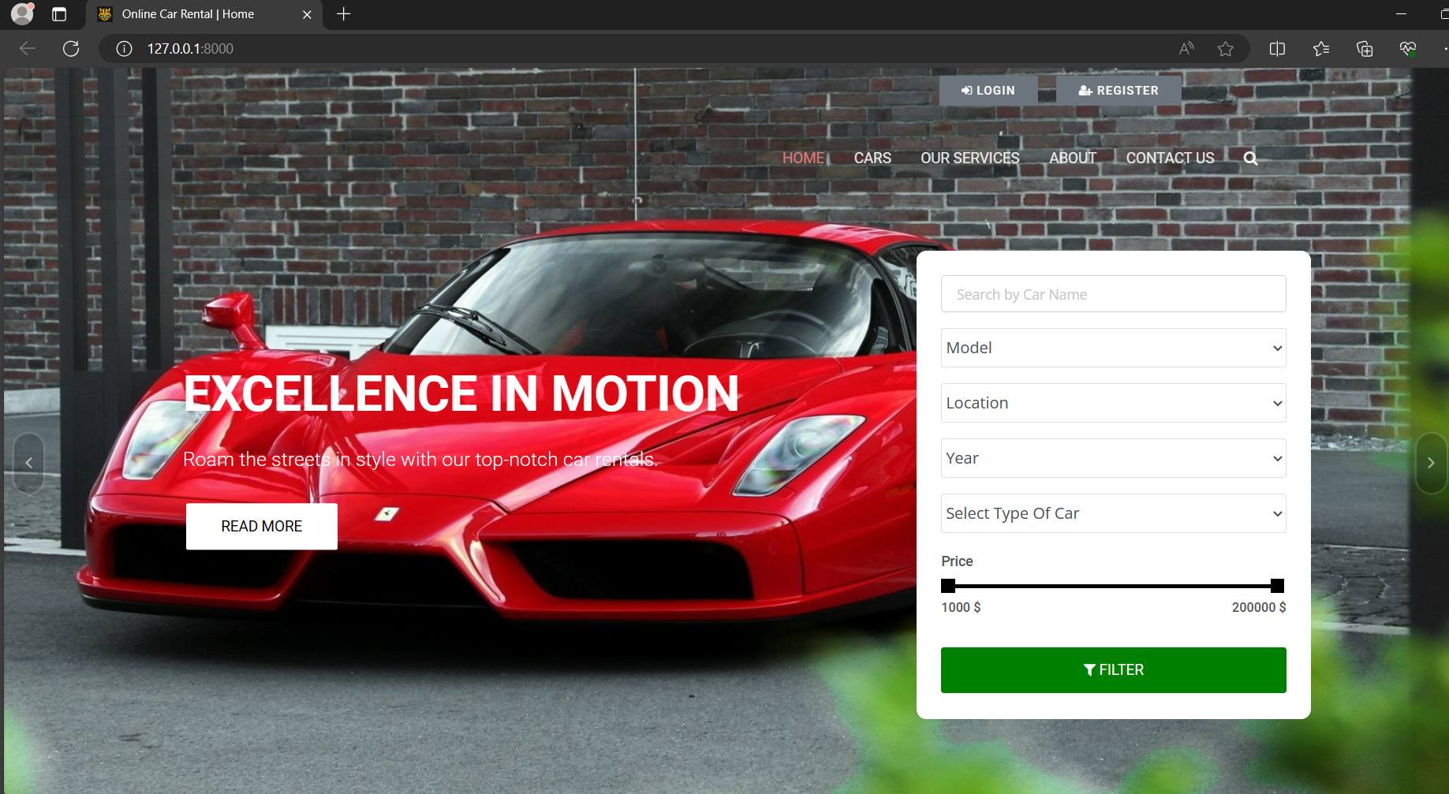
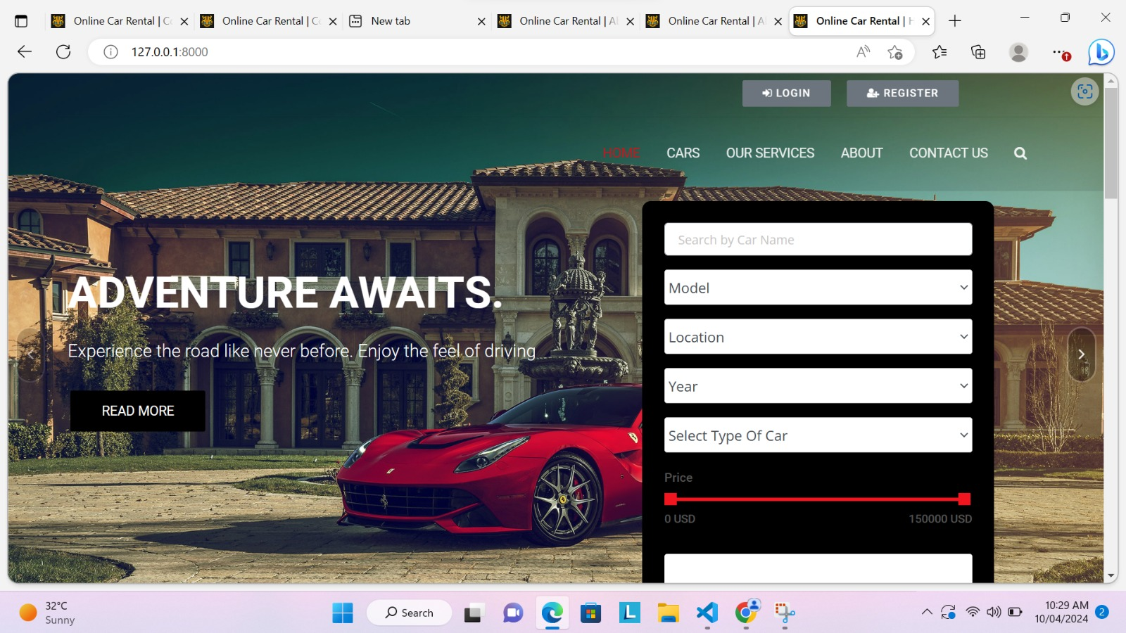
Homepage

Slide 10
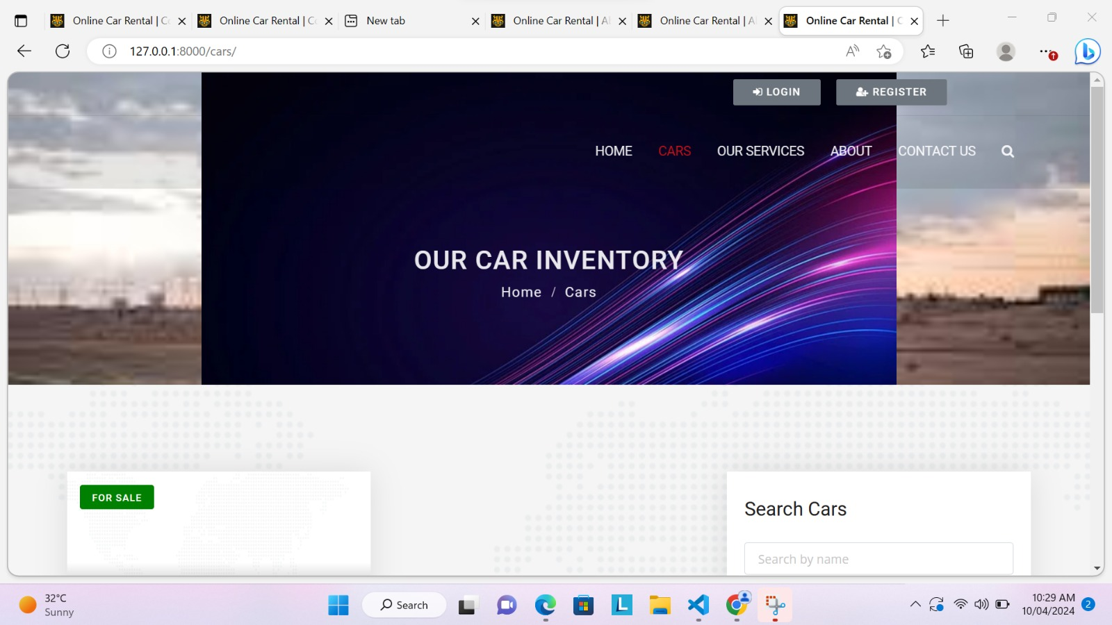
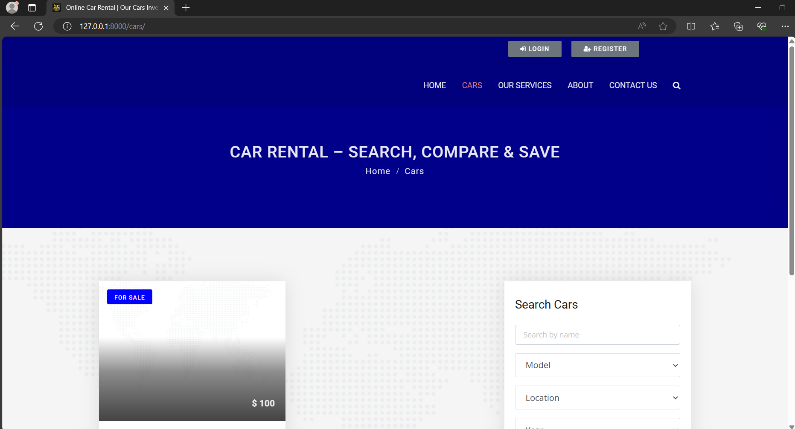
Cars-Page

Slide 11
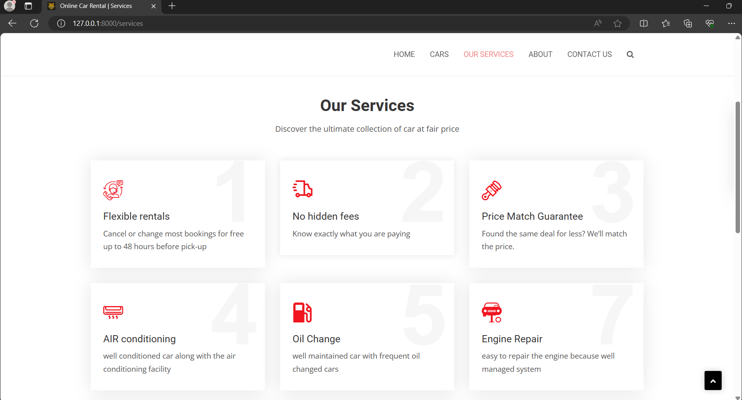
Our Service-Page

Slide 12
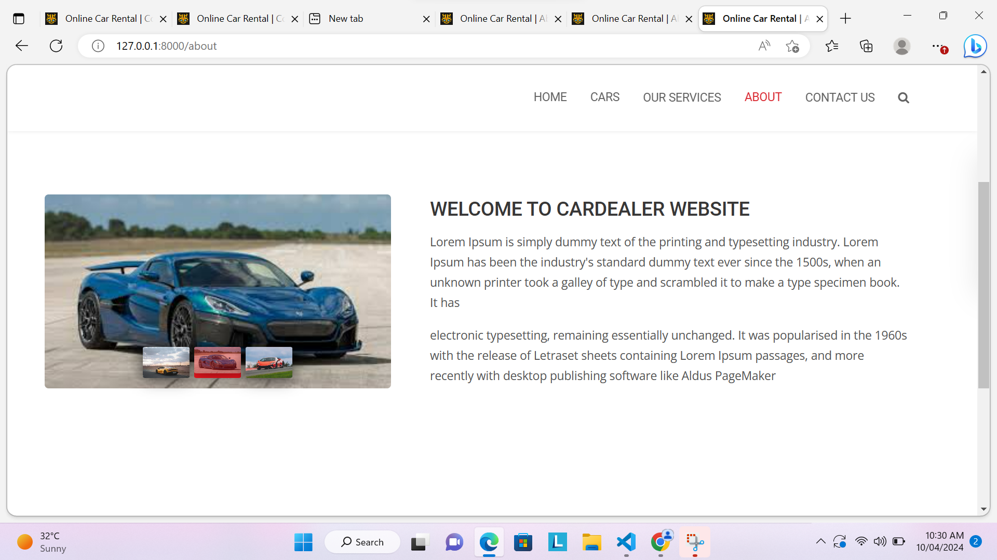
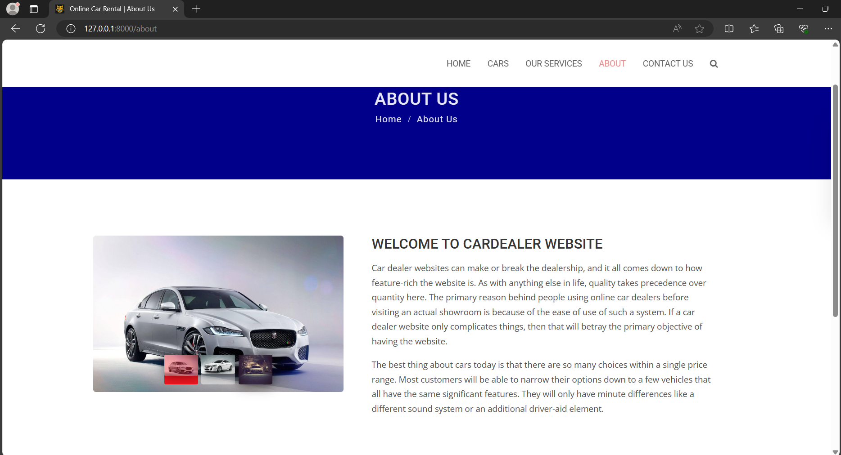
About-Page

Slide 13
Future Enhancements:
In the near future we try to improve the application by adding more features to it
Like GPS tracking, Low cost with higher customer satisification
We will spend more time to satisfy the concern of all the customers.

Slide 14
Conclusion
The Car rental application is very a useful application in the current environment
The main advantage of it, is provides the remote location access this the high needs of the today’s generation people
We also provided with the friendly user interface.
Easy to access by all the people.
Source :

Slide 15
Thank You!
Notes:
Thank You !!

